Slide 1

Airbnb &
Chicago Crime
Data Study Final Presentation
Team 3
Colleen Jung
Kevin Ko
Khushi Ranganatha
Saphir Qi

Slide 2
Agenda
Business Case Recap
Data Models
Exploratory Data Analysis
Lessons Learned & Recommendations
Text colour

Slide 3


Business Case Recap
Data Sources
Airbnb Listing Data
Chicago Crime Rate
Our Focus
Analyze factors affecting Airbnb pricing in Chicago, including property type, location, license status, and user reviews
Explore the impact of local crime rates on Airbnb listing prices in Chicago
Text colour

Slide 4
Agenda
Business Case Recap
Data Models
Exploratory Data Analysis
Lessons Learned & Recommendations
Text colour

Slide 5
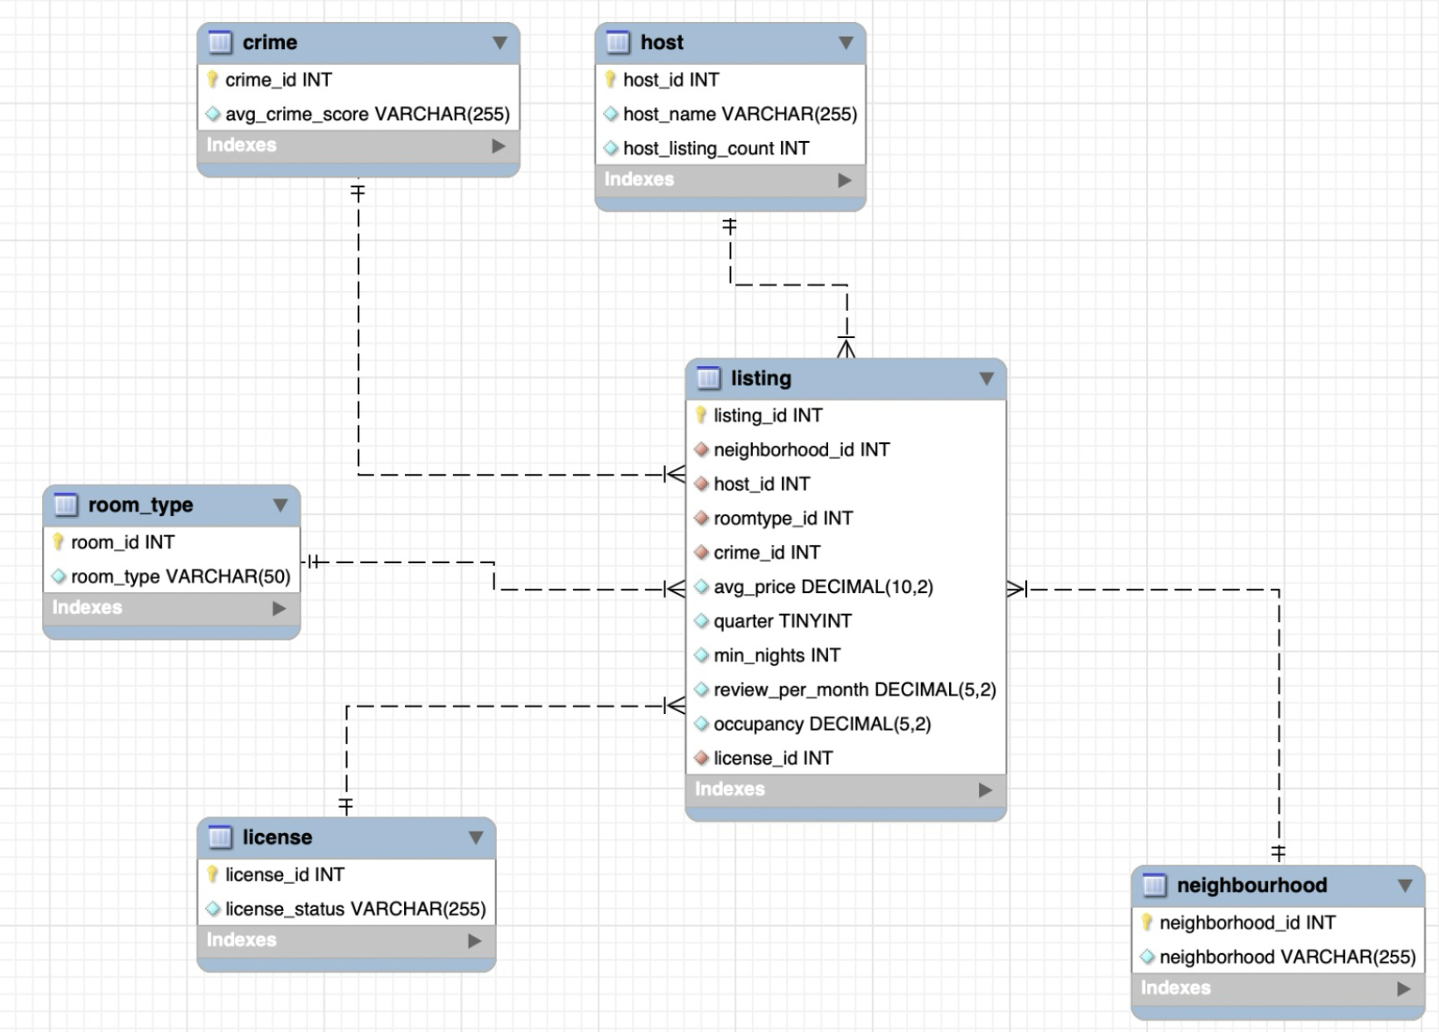
Data Model - EER

Slide 6
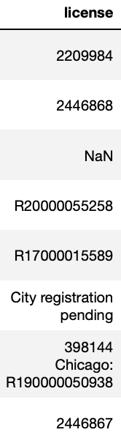
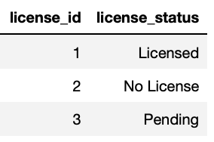
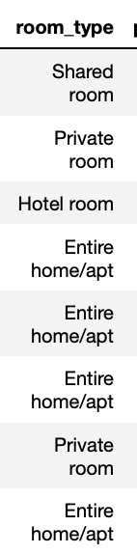
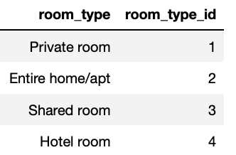
Data Transformation - Listing Data
Example 1 - License
Example 2 - Room Type
Original Data
Normalized Data
Original Data
Normalized Data
Licenses status are categorized into 3 groups:
With a license number -> Licensed
NaN -> No License
City registration pending -> Pending
All the room types are categorized into 4 groups and an unique room_type_id is assigned for each of them

Slide 7
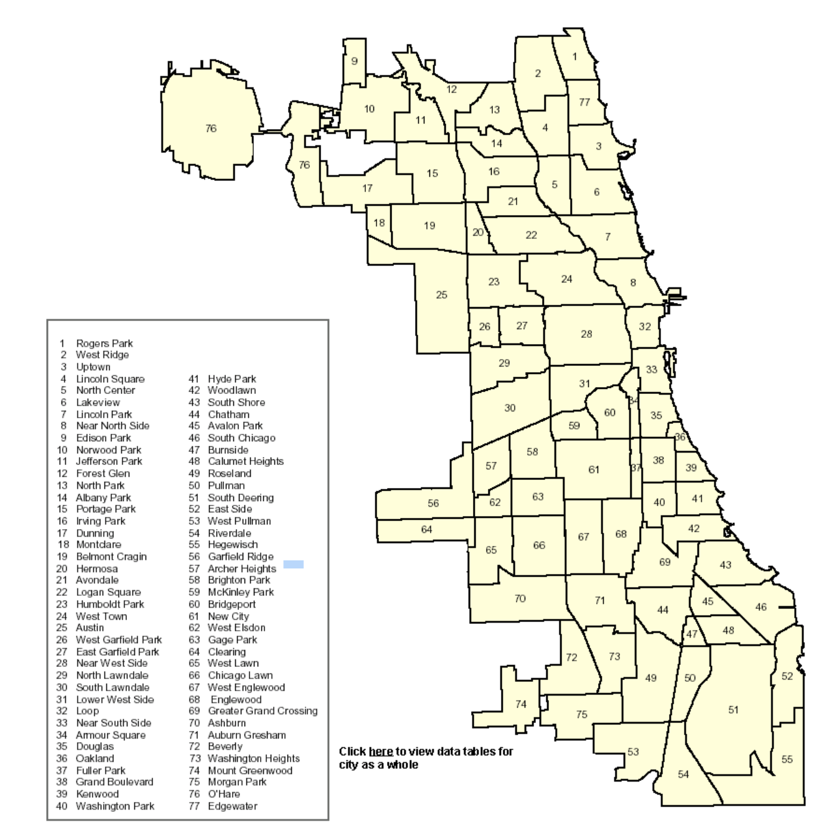
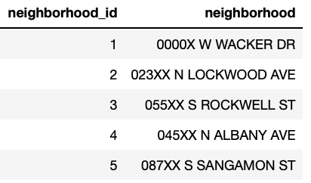
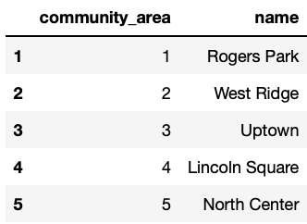
Data Transformation - Crime Data
Example 1 - Neighborhood
Example 2 - Community Area
- Defined to get a sense of ‘community_area’
- Assign ‘neighbourhood_id’ that falls in unique community code

Slide 8
Data Transformation -Crime Data
Crime Type
ID | Primary Type | year | quarter | neighbourhood
12876758 | BATTERY | 2022 | 4 | Uptown
12876833 | THEFT | 2022 | 4 | Rogers Park
12877365 | CRIMINAL DAMAGE | 2022 | 4 | Auburn Gresham
12877003 | THEFT | 2022 | 4 | Grand Boulevard
12877755 | THEFT | 2022 | 4 | Near South Side
12879013 | THEFT | 2022 | 4 | Lincoln Park
12877976 | THEFT | 2022 | 4 | Chicago Lawn
12877327 | BATTERY | 2022 | 4 | Lincoln Park
12878616 | OTHER OFFENSE | 2022 | 4 | Washington Park
12879098 | BATTERY | 2022 | 4 | Washington Heights
12876457 | MOTOR VEHICLE THEFT | 2022 | 4 | Roseland
12877395 | ASSAULT | 2022 | 4 | Near West Side
Score | Score_avg
7 | 5.82
5 | 5.86
8 | 6.12
5 | 5.9
5 | 5.88
5 | 5.6
5 | 6.06
7 | 5.6
2 | 5.96
7 | 6.0
5 | 6.13
8 | 5.69
Primary Type | Score
DECEPTIVE PRACTICE | 4
BATTERY | 7
THEFT | 5
CRIMINAL DAMAGE | 8
OTHER OFFENSE | 2
MOTOR VEHICLE THEFT | 5
ASSAULT | 8
CRIMINAL SEXUAL ASSAULT | 8
BURGLARY | 6
ROBBERY | 6
PUBLIC PEACE VIOLATION | 2
WEAPONS VIOLATION | 7
… | …

Slide 9
Agenda
Business Case Recap
Data Models
Exploratory Data Analysis
Lessons Learned & Recommendations
Text colour

Slide 10
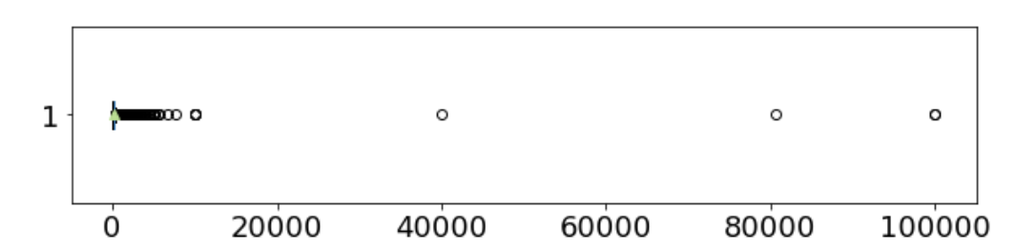
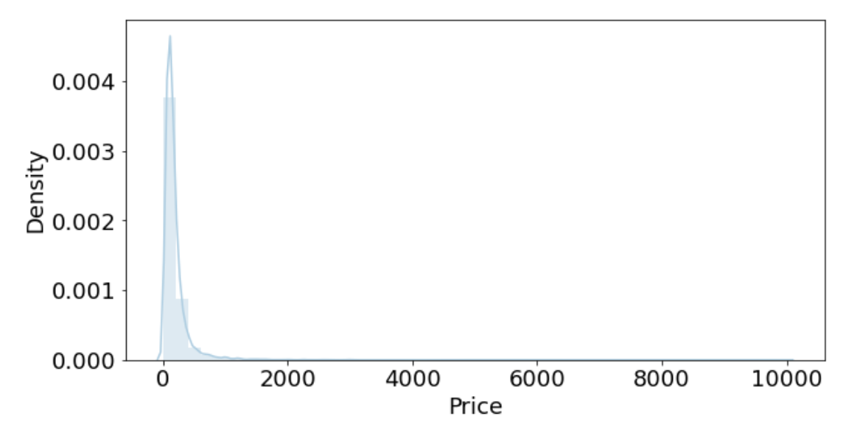
Exploratory Data Analysis
Listing Price Distribution
Factsheet
Max Listing Price | $99,998
Min Listing Price | $0
Average Listing Price | $199
Median Listing Price | $130
Standard Deviation | $974
Outliers Removed
Key Takeaways
Price Distribution Skewness: Right-skewed distribution with a concentration of listings at the lower price end, indicating a market dominated by more affordable rental options.
Variation in Listing Price: The wide range of listing prices indicates a diverse market from budget to luxury accommodations.
Outliers: The outliers on the higher end of the spectrum hint at the existence of premium listings
Text colour

Slide 11
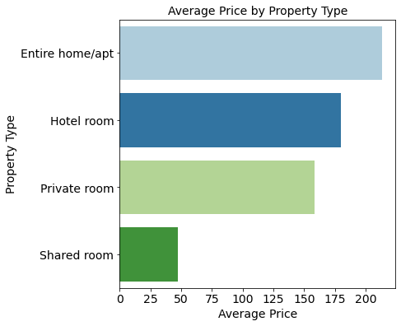
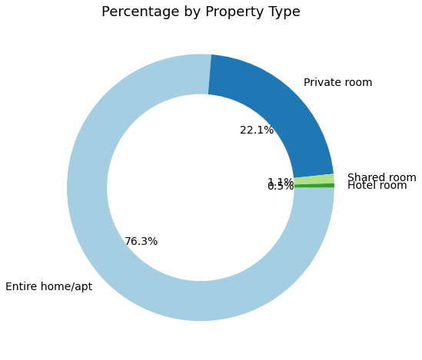
Exploratory Data Analysis
Property Type
Text colour

Slide 12
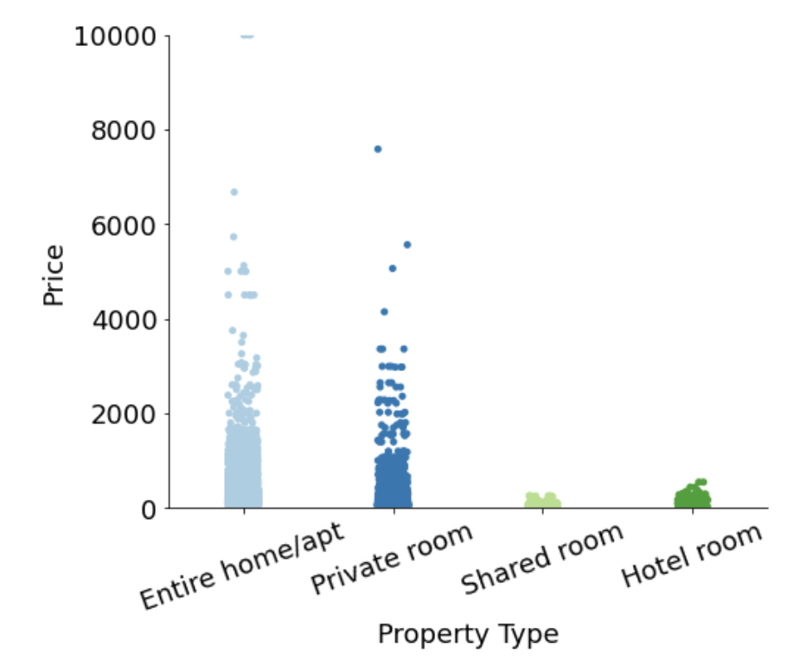
Exploratory Data Analysis
Property Type
Key Takeaways
Property Type Preference: The majority of listing supply are entire homes/apartments, driven by the higher demand for privacy and space.
Average Price by Property Type: Entire homes/apartments have the highest average price, followed by hotel rooms and then private rooms, suggesting that space and exclusivity come at a premium.
Distribution of Prices: There's a wide range of prices within each property type, especially with entire homes/apartments, as indicated by the significant outliers.
Text colour

Slide 13
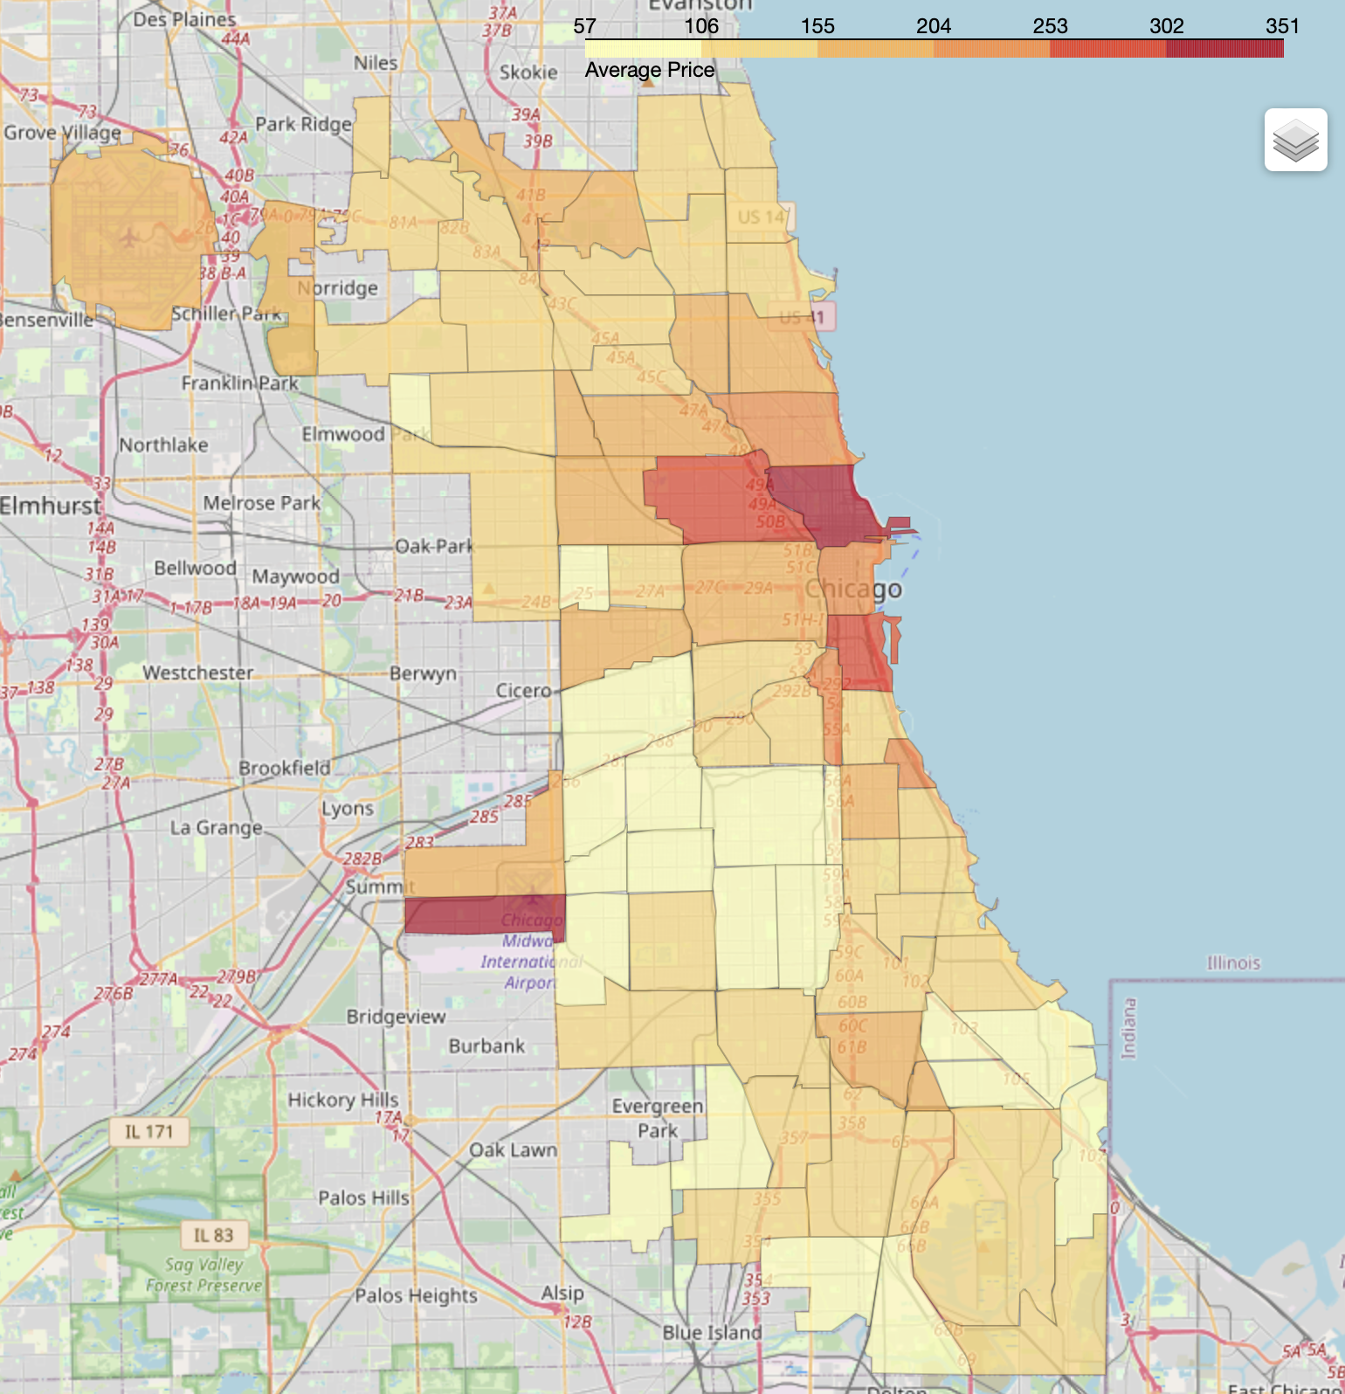
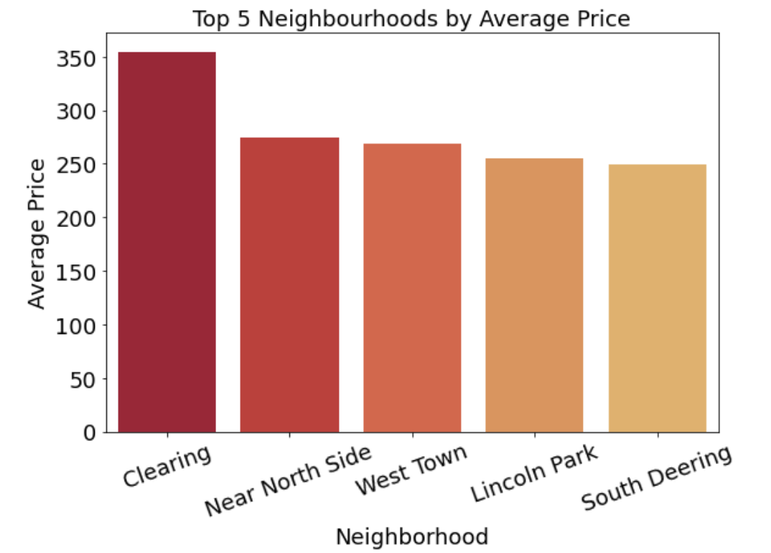
Exploratory Data Analysis
Spatial Data Analysis
- Average Price By Neighborhood
Text colour

Slide 14
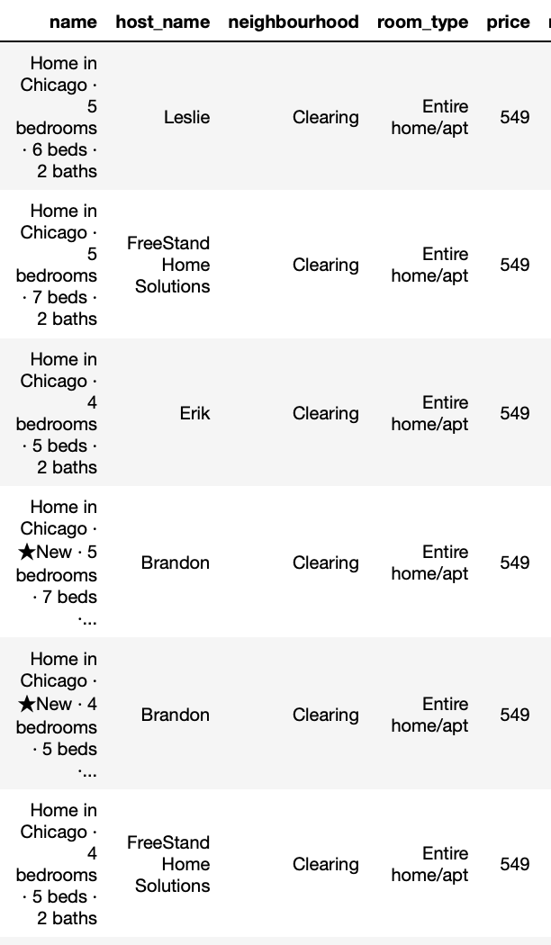
Exploratory Data Analysis
Why Clearing is the most expensive neighbourhood?
– Likely to be driven by one professional agency
Text colour

Slide 15
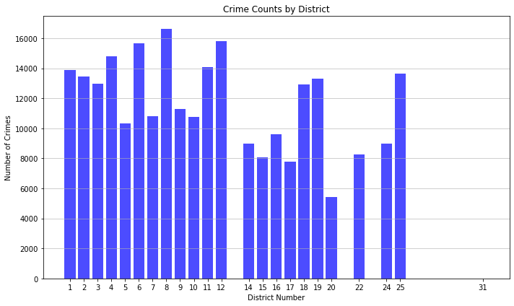
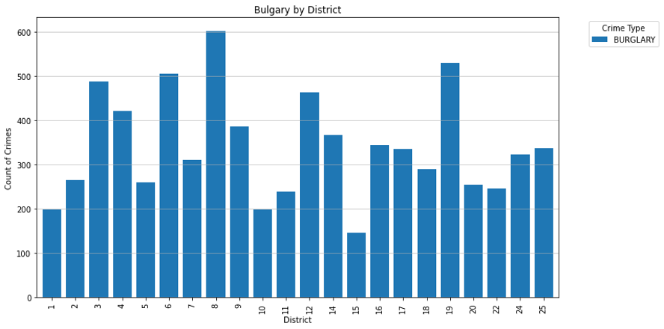
Exploratory Data Analysis
No significant information between the total crime rate between the districts
District population data is crucial when analyzing crime rates to gain a more comprehensive understanding of the local safety landscape to compare with Airbnb listing
Create a numeric scale for crime types to calculate neighborhood-specific average crime rates relevant to Airbnb listing prices.

Slide 16
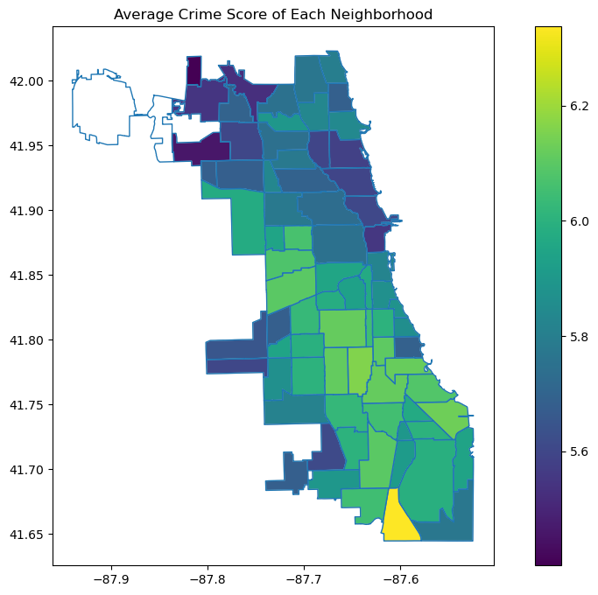
Exploratory Data Analysis
Key Observations
The graph presents a heat map of Chicago's neighborhoods, color-coded by the average crime score
There is a visible pattern where certain neighborhoods with higher crime scores are associated with Airbnb housing pricing trends.
“Safest” Neighbourhood: Edison Park
“Most Dangerous” Neighbourhood: Riverdale

Slide 17
Summary by Neighborhood
Average Price
Average Crime Score
HIGH
LOW

Slide 18
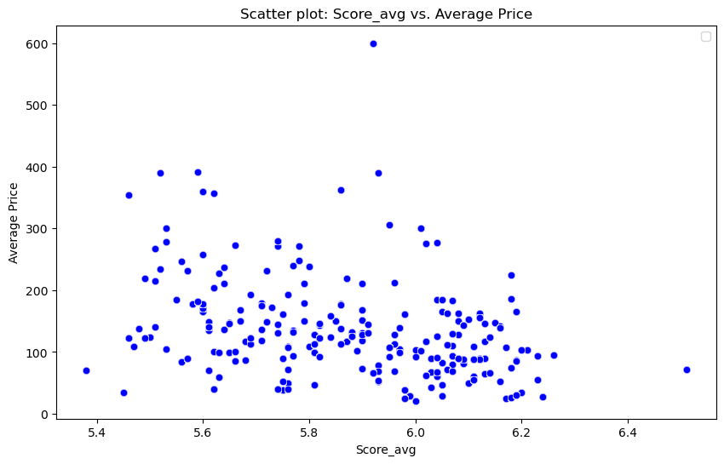
Exploratory Data Analysis
Negative trend between average cime score and average price
Higher average listing price generally have lower average crime score
Coefficient of -0.6

Slide 19
Agenda
Business Case Recap
Data Models
Exploratory Data Analysis
Lessons Learned & Recommendations
Text colour

Slide 20
Lessons Learned
Data does not lie, but it can be misleading:

Slide 21
Recommendations
For Airbnb Hosts
Competitive Pricing: Encourage hosts in high crime rate areas to adjust their pricing to remain competitive.
Safety Features: Advise hosts to invest in additional safety features and to clearly communicate these enhancements to potential guests.
The City of Chicago
Policy Changes: Advocate for policy changes that support increased safety measures in neighborhoods with lower Airbnb activity
Collaboration with Airbnb: Work alongside Airbnb to develop community programs that address guests' safety and support local law enforcement efforts
Further Research
Broader Analysis: Expand the scope of research to consider additional factors like local amenities, seasonal trends, and economic conditions.
Comparative Studies: Conduct studies in other cities to provide comparative insights and develop a more comprehensive understanding of the dynamics between crime rates and short-term rental prices.

Slide 22



Slide 23
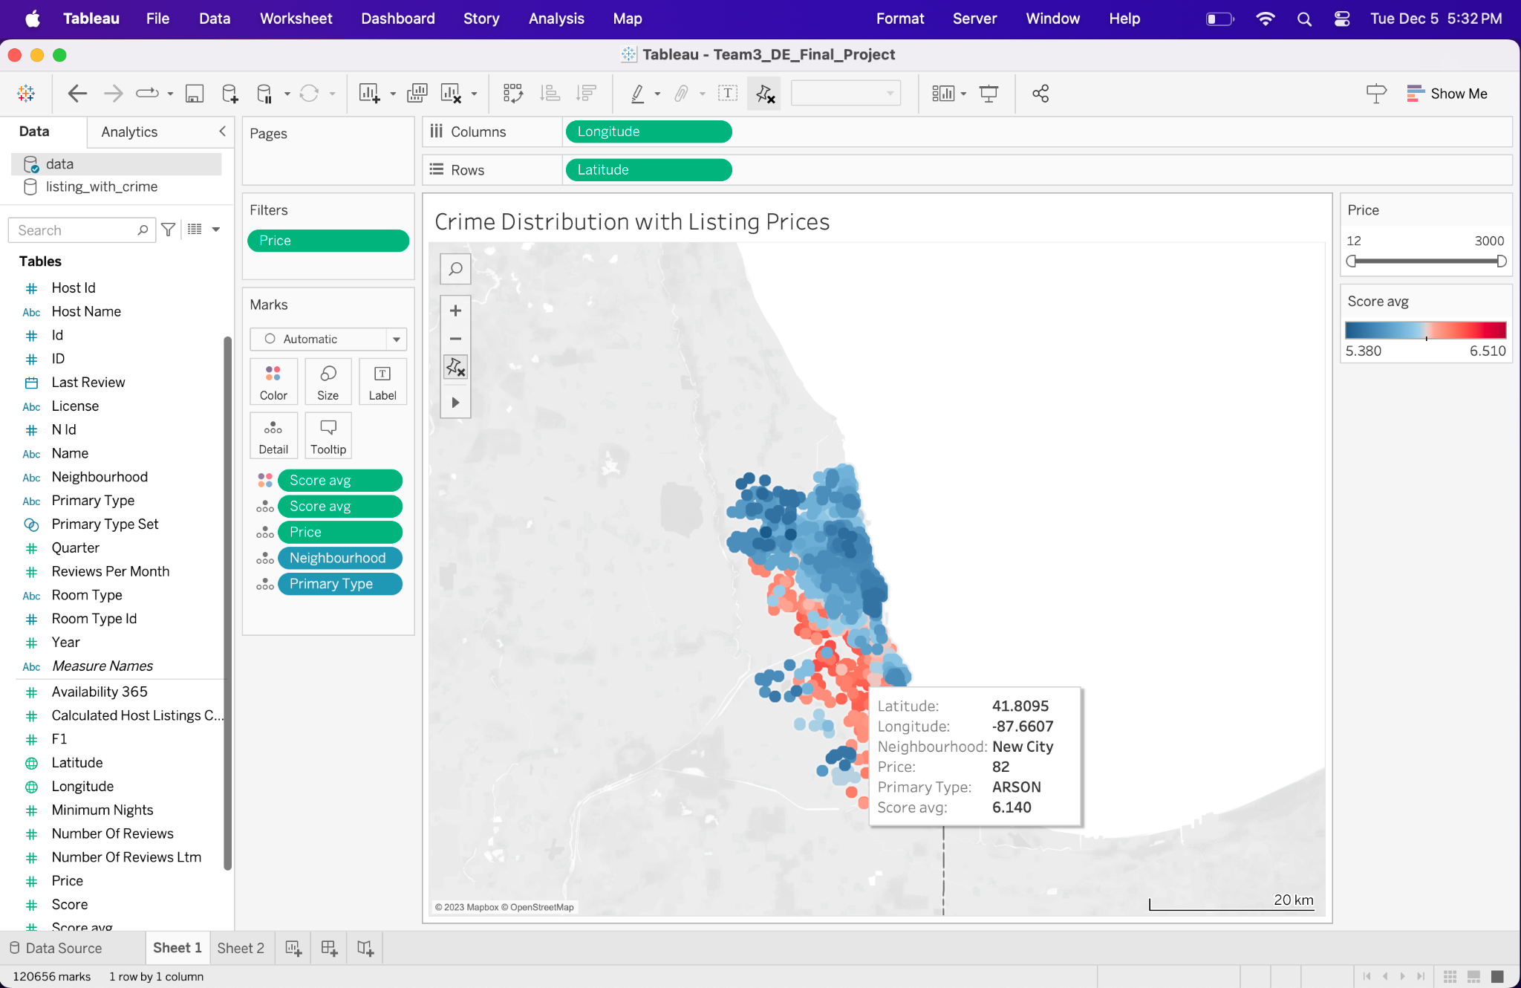
Appendix A - Visualization of Crime and Listing Data (Listing Price at Full Scale)

Slide 24
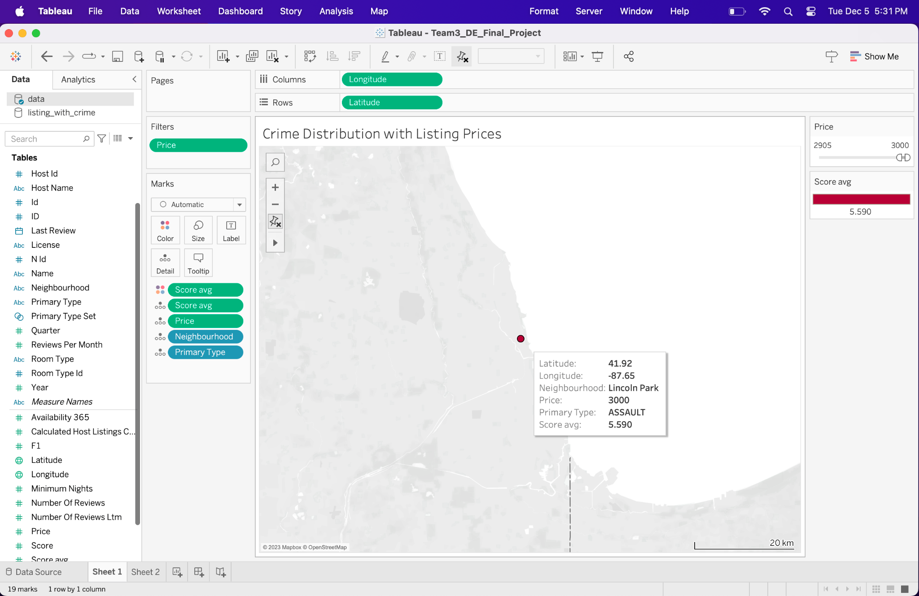
Appendix A - Visualization of Crime and Listing Data (Listing Price at Modified Scale)

